Slide 2
CONTENTS
Abstract
Introduction
Motivation
Literature Review
Objective
Methodology
Flow Chart
References

Slide 3
MINOR-1 Image Segmentation
500076426 500076502 500075381 500075382 | R177219095 R177219080 R177219070 R177219100 | Jay Gupta Gaurav Sharma Dev Singh Ketan Chawla | CSE – AIML CSE – AIML CSE – AIML CSE - AIML
Under the guidance of
Prof. Goutam Datta
(Assistant Professor)

Slide 4
Abstract :-
.
Image segmentation is a vital step in image processing and is widely used in face recognition, object detection, autonomous cars, medical imaging, etc. There are different techniques to achieve image segmentation. Region-based, thresholding, edge detection and clustering are some of them. This project analyses and compares the results of these different image segmentation techniques.

Slide 5
Introduction :-
Image segmentation is the process of partitioning an image into different regions based on their features. Image segmentation has lots of application in different areas, like it is used in the face recognition technology which is used in security systems, image segmentation is used in object detection, in the medical science as a way to locate and identify fractures, damaged tissues and cells and also used in search engines that offers image-based searches.
There are different techniques through which image segmentation can be done. Following are some of them:
• Thresholding-based segmentation
• Region-based segmentation
• Clustering-based segmentation
• Edge detection-based segmentation

Slide 6
Thresholding Based Algorithm:
Otsu’s algorithm is a thresholding based image segmentation technique.
Based on the distribution of image pixel values, a threshold value is selected.
Two regions will be formed, based on this threshold value.
Clustering Based Algorithm:
K-means is a clustering based image segmentation technique.
Similar pixel values will be present in same cluster/region.

Slide 7
Edge detection:
Sobel operator is a edge detection operator.
It comprises of two 3x3 matrices, one to detect horizontal edge and the other to detect vertical edge.
This operator is applied on the pixels of the image to detect edges in it.
Region-Growing Segmentation:
A seed point is selected
Then its pixel value is compared with its neighboring pixels
If values are close enough will be included into the region
And the process continues until region stop growing.

Slide 8
Motivation :-
Image processing especially image segmentation is used as a core technology in a large number of modern applications and systems. Image Segmentation plays an important role in the medical field. It is considered as the most important medical imaging process as it extracts the region of interest through an automatic process. Hence, we got the motivation to build a project on image segmentation as it is used to save billions of lives.

Slide 9
Literature Review :-
Lots of works and research papers have been published on image segmentation. Following
are some of them:
Image segmentation algorithm overview by Song Yuheng and Yan Hao gives an overview of
different techniques used to achieve image segmentation. This paper analyses and compares
the advantages and disadvantages of different algorithms. It also shows that it’s very difficult
to find a segmentation technique that works well with all kinds of images.
Clustering Techniques for Digital Image Segmentation by Bharti Tanwar, Rakesh Kumar,
Girdhar Gopal gives detailed information about the clustering-based segmentation. K-means
is a clustering technique used to achieve image segmentation. In this paper, details of the
algorithm have been provided with the implementation result.
Research and analysis of Image edge detection algorithm Based on the MATLAB by Guowei
Yang, Fengchang Xu explains how edge detection is a very effective method for image
analysis. It compares the results of different operators used to detect edges in images. It also
proposes a log Sobel algorithm which is an advancement on Sobel algorithms.

Slide 10
Objective :-
To compare the results of different image segmentation techniques.

Slide 11
Methodology :-
Firstly, we use the c/c++ library to read image pixel values. Then apply following algorithms one by one to achieve image segmentation: 1. In thresholding-based segmentation firstly, using some statistical calculation, threshold value T will be calculated. Then based on T value each pixel will be assigned to a region. 2. In region growing a point (pixel) in the image is selected randomly and then compare with its neighbouring pixels, if they satisfy the similarity criteria they will be added in the region and the same process is recursively applied until the region stops growing and a region is assigned to each pixel 3. The K-Means algorithm will be used in the clustering-based approach. It makes K clusters (or regions) of the pixels based on their similarity. 4. In edge detection we identify edges according to the differences in texture, contrast, grey level, colour, saturation, and other properties. And we use the gradient operator to detect the edges Finally, the results of all the algorithms will be compared.

Slide 12
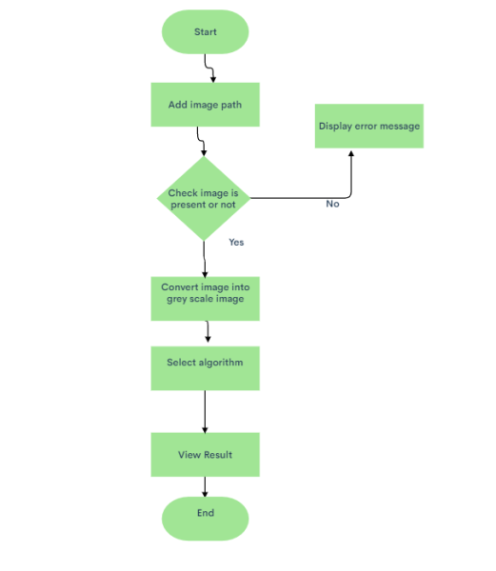
Flow Chart :-

Slide 13
References :-
There is a research paper in which there is comparison of region-based segmentation. In this paper there is a comparison of two segmentation algorithm i.e., region growing and region merging.
Title: Region growing and region merging segmentation
Reference: https://ieeexplore.ieee.org/abstract/document/628077/references#references
There is a research paper in which there is comparison of every segmentation algorithm and find out how to combine these algorithms and use effectively.
Title: Image Segmentation Algorithms Overview
Reference: https://arxiv.org/abs/1707.02051
There is a research paper in which there is a comparison of each and every algorithm and finding the complexity, segmentation effect, flaws and improvements scope in those segmentation algorithms and also find which image is suitable for which algorithm.
Title: The Comparative Research on Image Segmentation Algorithms
Reference: https://ieeexplore.ieee.org/abstract/document/4959132
There is a research paper in which there is detail study of clustering segmentation.
Title: Clustering Techniques for Digital Image Segmentation
Reference:https://www.ijser.org/researchpaper/Clustering-Techniques-for-Digital-Image-Segmentation.pdf

